Slide 1
Checkpoint 1:
Web fundamentals project
Directed by : Aissaoui yassine

Slide 2
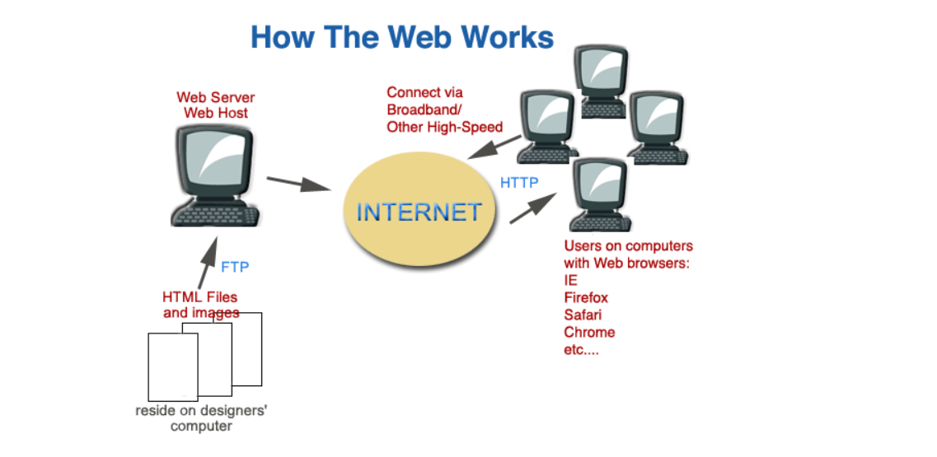
How does web the work?
the The Web (World Wide Web)
The World Wide Web, or simply the web, is a way of accessing information through the medium of the Internet. It is an information-sharing model that is built on top of the Internet. The web uses the HTTP protocol, one of the languages spoken over the Internet, to transmit data.
Web services that use HTTP allow applications to communicate, exchange business logic and use the web to share information. The web also utilizes browsers such as Google Chrome, Internet Explorer or Firefox, to access Web documents called web pages that are linked to each other via hyperlinks.
Web documents also contain graphics, sounds, text and video.

Slide 3
What do you need to be a web developer?
To become a Web Developer, you should have an understanding of HTML, CSS, and JavaScript. It's also recommended to learn about CSS and CSS frameworks. Developing these fundamental web development skills will give you the foundation and logic for communicating with programming languages.
A developer must have an analytical mind and a certain rigor in order to clearly organize your code, spot an error, structure or reason.

Slide 4
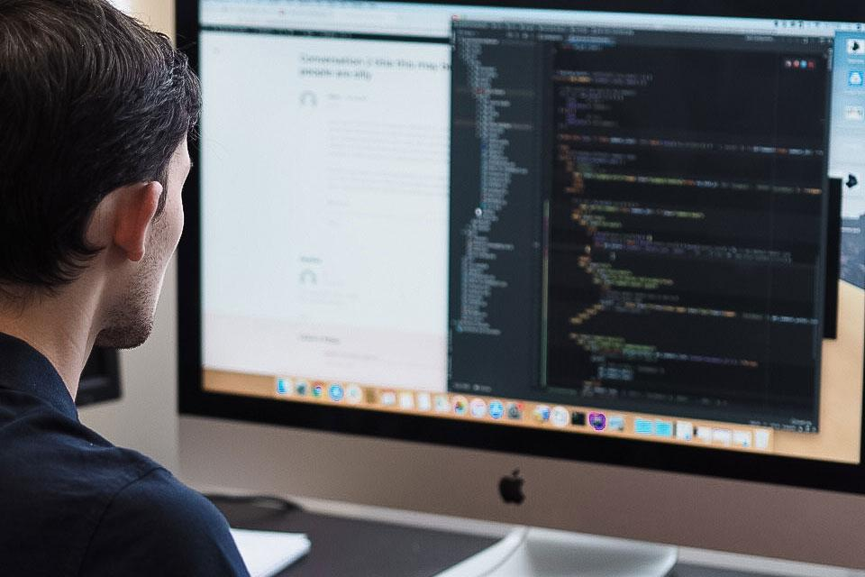
What is the role of a web developer?
The role is responsible for designing, coding and modifying websites, from layout to function and according to a client's specifications. Strive to create visually appealing sites that feature user-friendly design and clear navigation.
Web developers are familiar with technology and understand how computers and web servers operate. They are also very familiar with many software programs, web applications and web programming languages, such as hypertext markup language (HTML), JavaScript (JS), Ruby on Rails, and C++.

